Slide 1
Antisocial Personality: Approaches to Treatment
Alaska School on Addictions and
Behavioral Health
Anchorage, May. 2015
Bruce Carruth, Ph.D.,
San Miguel de Allende, GTO, Mexico

Slide 2
The story of Dan
Can antisocial people change?
Yes, but we have to offer the resources and treatment antisocial people need
It really DOES take a community
Living with a legacy of poor social skills, a history of interpersonal disasters and a residue of psychological trauma
Bruce Carruth, Ph.D.

Slide 3
a model for three types of psychiatric
/ psychosocial disorders
1. Disorders primarily of brain chemistry / brain functioning:
Schizophrenia, bi-polar disorders, anxiety
disorders, most depressions, dementia
2. Disorders primarily of self in relation to others:
Personality disorders, addictions, family disorders,
many aspects of trauma disorders & ADHD
3. Disorders primarily of self in relation to society:
The antisocial disorders: amorals, impulsives and sadists
Bruce Carruth, Ph.D.

Slide 4
Unifying characteristics of antisocial disorders: the disorders of self in relation to society
1. acting out or acting on – aggression
– neurotics act “in” / antisocials act “out” against
rules, norms, expectations
– “don’t mess with me”
– bully behavior
2. Getting “over on” – power and control
– “nobody tells me what to do”
– “I can get away with it” – grandiosity
– Uncomfortable when not in control
– Projects impotence: “You’re a loser”
Bruce Carruth, Ph.D.

Slide 5
Unifying characteristics (con’t)
3. Lack of concern / sensitivity for others
– arrogance – “my needs come first”
– exploitive of others
– “I didn’t hurt anybody”
4. Lack of self care
– looks vain and self-absorbed, but doesn’t take
very good care of self
– often looks older than their age as they age
– poor emotional self-care: loaded with grief
Bruce Carruth, Ph.D.

Slide 6
Unifying characteristics (con’t)
5. Inability to self stimulate
– use environment to stimulate emotions
– have trouble self-stimulating
– “lets have some fun”
6. Emotional deprivation
– “Act” feelings but are feeling repressed
– low on empathy
Bruce Carruth, Ph.D.

Slide 7
Unifying characteristics (con’t)
7. Poor interpersonal relationships
– see relationships through mirror of manipulation
“Did I ever tell you about this old girl I used to live with”
– superficial & glib in relationships with others
– particularly difficult relationships with opposite sex
8. Perception of self as victim, disowning responsibility
– low on guilt, high on remorse
– gets anxious if challenged about responsibility
– projects victimhood on to others, then denigrates them
– minimize violations of social norms
– spousal abuse – “difference of opinion”
– stealing – “bad judgment”
Bruce Carruth, Ph.D.

Slide 8
In a moment in time ….
• Most antisocial people don’t LOOK antisocial most of the time.
• At a party you probably couldn’t pick the people who are on
the antisocial spectrum.
• People on the antisocial spectrum often read others well and can
be charming and engaging… do “impression management” well
• We ALL exhibit antisocial behavior. The meaning of antisocial
pathology comes in the PATTERN and the CONTEXT of the
behavior
Bruce Carruth, Ph.D.

Slide 9
Differentiating antisocial behaviors and antisocial character structure
• Everybody, and especially addicted people, have sometimes
behaved in an antisocial manner.
• Antisocial character structure is an engrained pattern of
behavior, thinking, feeling and relating that consistently
impacts how a person engages their world.
Bruce Carruth, Ph.D.

Slide 10
Commonality with addictive illness
We see the outsides…
addicts antisocials
inconsistency conning
drug use emotional immaturity
manipulating self centeredness
lack of awareness getting over on others
impression management drug use
Bruce Carruth, Ph.D.

Slide 11
Commonality with addictive illness
…and we lose sight of the insides that are driving those outsides and then just react to (and judge) the behavior
It is important to recognize the “insides”, the drivers of the behavior,
(but responding to the underside too early will make antisocial people very uncomfortable and they will run from treatment)
Bruce Carruth, Ph.D.

Slide 12
The undercover side of antisocials
1. Remarkably insecure, inadequate people
2. Filled with shame – fears someone will find out / fears
exposure of real self
- Hides self from self as well as from others
3. Have underdeveloped conscience and sense of social
responsibility – lo guilt, hi remorse
4. Highly anxious – covers with acting out/on
- Anxious often gets changed to angry
- Loves to tell stories of how anxiety was mastered
Bruce Carruth, Ph.D.

Slide 13
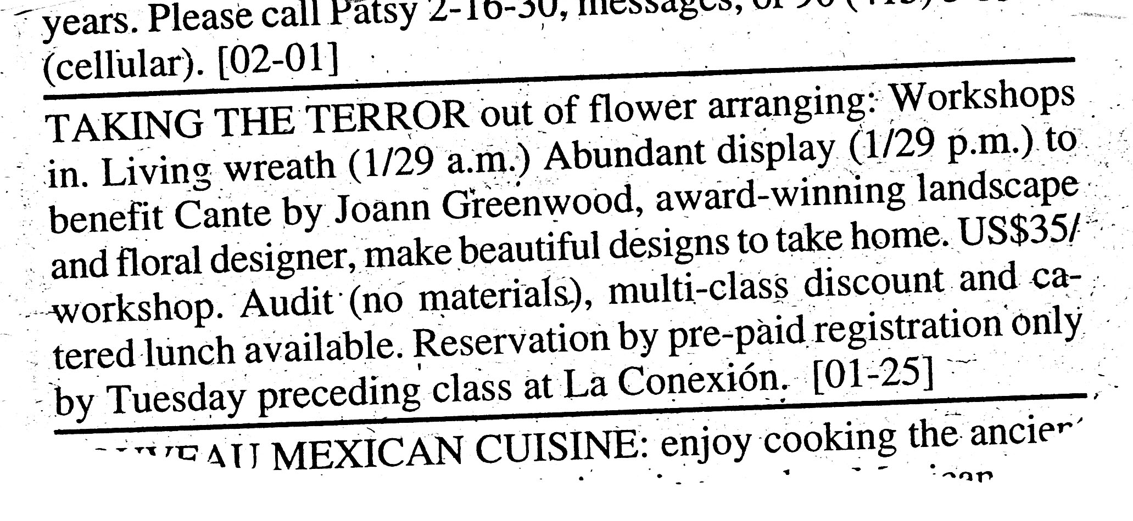
Bruce Carruth, Ph.D.

Slide 14
Undercover side (con’t)
5. Low on motivation for change – stimulus for change has
to come from the outside
6. Hard time sustaining motivation – better on plans and
wishes than action
7. Very immature, socially, interpersonally, educationally,
spiritually
Bruce Carruth, Ph.D.

Slide 15
Why do you find antisocials in addiction treatment settings?
1. Because they use a lot of drugs
2. Because it beats going to jail
3. It helps cool things with spouses, employers
4. People see the drug use and assume drugs are the
problem
5. Because they tend to have a high relapse rate
6. Because they often really do want to “straighten up”
(and nobody else wants to treat them)
Bruce Carruth, Ph.D.

Slide 16
Why do antisocials have trouble in addiction treatment settings
• Have trouble with authority and following rules
• Are not in control
• Shame is activated by asking for help / being “sick”
• Being in treatment is not good for the image
• Hates feeling like a victim, a loser (“We admitted we are
powerless …”)
• Gets nervous when confronted
with feelings, with behavior, with interpersonal interactions
• Unmotivated to do what is being asked
• If (s)he has a different agenda for being in treatment
• Sees life as manipulating, “getting over on” to get what (s)he
wants – antithetical to addiction recovery. Enjoys beating the
system
Bruce Carruth, Ph.D.

Slide 17
What “works” in addictions treatment doesn’t necessarily work with antisocials
• Confrontation
• Group sharing and identification
• Emotional expression
• Personal responsibility
• Accountability for behavior to others
• Self-assessment
• Belonging and connecting with others
• Tapping hope and a desire to change
Bruce Carruth, Ph.D.

Slide 18
Some misimpressions of antisocials
1. They are all in jail
2. Antisocials are at the “bottom of the barrel”
socially, economically, in employment
3. Mostly found among minorities
4. Are almost always men
5. Are all alike – unified set of symptoms
6. Less susceptible to other psychiatric disorders
7. Are smarter than average
8. They outgrow antisocial behavior
Bruce Carruth, Ph.D.

Slide 19
Psychopaths, Sociopaths, Antisocials & Dyssocial Personality
– Diagnostic labels are culturally bound:
psychopaths to sociopaths to antisocials to dyssocials
– Psychopaths versus sociopaths
– Antisocial (DSM 5) and
dissocial (ICD 10) personality disorder
– Once we lump people in a category, we tend to assume
everyone in that category has all the same characteristics
Bruce Carruth, Ph.D.

Slide 20
Antisocial people, below the façade, feel impotent and vulnerable
– They use anger as an empowering emotion to reduce the
feelings of impotence and vulnerability
– Antisocial people are angry a lot of the time
– Confronting the anger “head on” often increases the sense
of vulnerability thereby increasing the anger
Bruce Carruth, Ph.D.

Slide 21
We don’t tend to like treating angry people
– Our emotional & behavioral responses to angry people
– Anxious people, sad people and angry people and psychiatric
diagnoses
–“Anger management” needs to get below the symptom
– In treatment, managing overt versus covert versus
passive-aggressive anger
Bruce Carruth, Ph.D.

Slide 22
The Story of Beth
Female antisocials may not look like male antisocials.
They are not found with the same frequency in the
criminal justice system
They are less likely to be violent or threaten violence
The antisocial behaviors may be different
Most treatment paradigms for antisocials are oriented
towards men
Female antisocials are often misdiagnosed as borderline or
histrionic personality disorders.
Women who are antisocial may have a higher incidence of trauma disorders
Bruce Carruth, Ph.D.

Slide 23
The antisocial spectrum
Bruce Carruth, Ph.D.

Slide 24
A matrix for understanding the antisocial spectrum
TYPES OF DISORDER AMORAL IMPULSIVE SADISTIC
LEVEL OF IMPAIRMENT:
TRAITS
PATTERNS
DISORDER
PSYCHOTIC
Bruce Carruth, Ph.D.

Slide 25
Four levels of impairment with antisocials
1. Character trait disturbance
• Functions well in society
• Antisocial part may be hidden from others
• May be highly successful (by societal standards)
• While antisocial traits are present, there is some control
over the trait
• May compensate for antisocial traits by doing well in some areas
of life: Glib and engaging, May be overly generous to others,
Active in community affairs, Good parent, Protective of children
and elderly, May have lots of $$$$
• Can learn from their mistakes & make changes
Bruce Carruth, Ph.D.

Slide 26
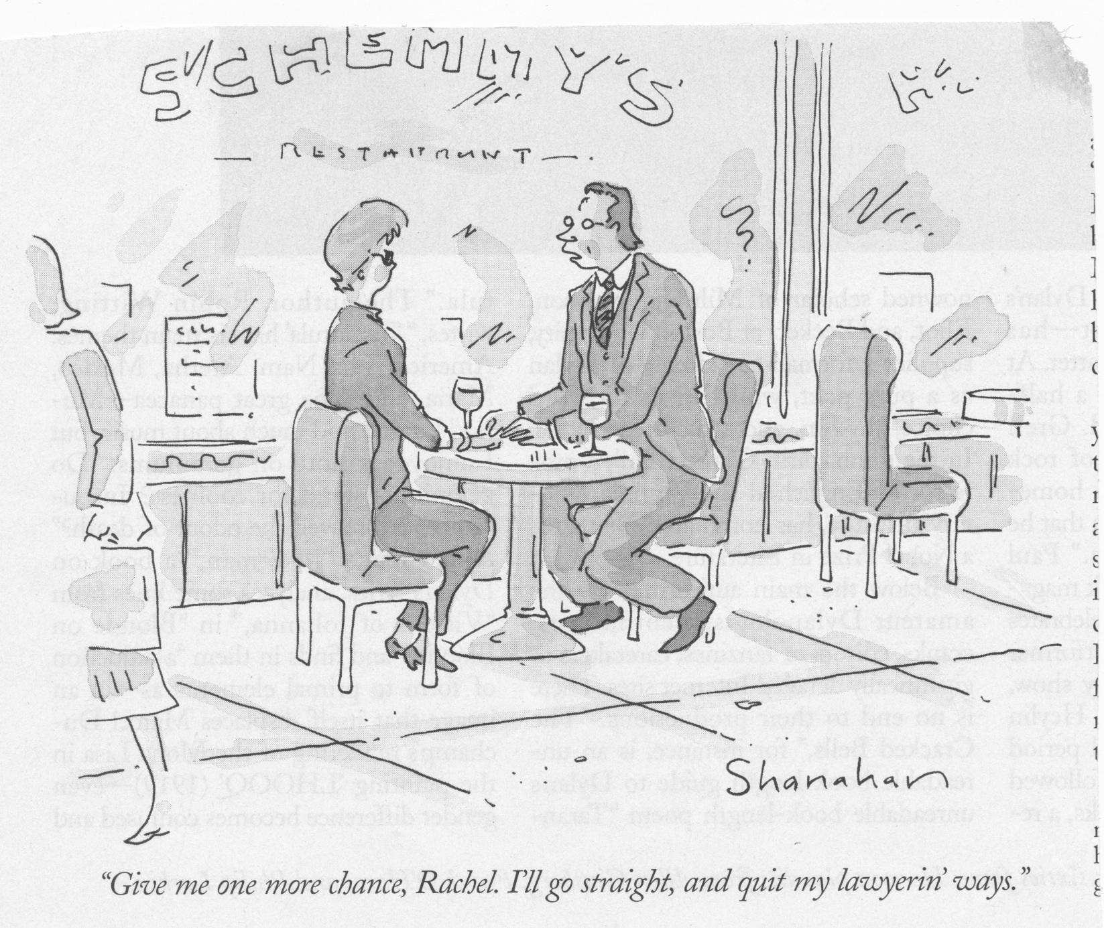
Bruce Carruth, Ph.D.

Slide 27
Implications for treatment
– Can self assess and critically judge their behavior (doesn’t
mean they want to change)
– Can access painful history and make connections to present
behavior
– Have a capacity to connect with others
– Has access to feelings, though may displace the feeling (turn
sadness or scare into anger)
– Can hear feedback (tho might not take it)
Bruce Carruth, Ph.D.

Slide 28
Four levels of impairment with antisocials
2. Character Pattern Disturbance
• Can’t hide antisocial symptoms as well
• Less adaptable to change (symptoms more entrenched)
• Ego defense is more rigid, less insight
• More limited in interpersonal functioning
• Life is more defined by limited parts of personality
• Childhood wounds may limit adult functioning
• Recognizable developmental failures in childhood and adolescence
Bruce Carruth, Ph.D.

Slide 29
Implications for treatment
– Have a more pervasive history of impairment and trauma -
Repressed childhood trauma & childhood developmental failures
– Stronger focus on behavior in treatment, less on feelings and
thoughts
– Longer time to develop the relationship and the ruptures in
the relationship will be more severe
– Therapist has to carefully craft feedback
– In general, fewer strengths to build upon
Bruce Carruth, Ph.D.

Slide 30
4 levels of impairment (con’t)
3. Antisocial Personality Disorder
• A pervasive pattern of rigid character structure that limits options in life. Failures in psychosocial development early in life set up a pattern of maladaptive coping, limited resources and skills and a poor sense of self. This inability to handle life maintains the trauma in adulthood
• Limited resources for staying out of trouble
• Don’t learn from mistakes and keep shooting themselves in the foot.
Bruce Carruth, Ph.D.

Slide 31
Implications for treatment
– Almost always need a major conversion experience as a
precursor to change: TC, church, cult
– Need strong boundaries to control behavior
– Major trauma in history that limits opportunities to go inside
to access thoughts and feelings – huge shame & underlying
depression
– Limited recovery strengths
– Doesn’t learn from mistakes so self-evaluation has limited
usefulness
Bruce Carruth, Ph.D.

Slide 32
4 levels of impairment (con’t)
4. Psychotically disorganized antisocials
Personality disordered people with periods of psychotic disorganization marked by dissociation, depersonalization,
cognitive distortions, delusions and/or inability to control
actions.
Antisocial people aren’t immune to psychotic illnesses, like schizophrenia, bipolar illness, major depressions.
May be precipitated by antisocial condition (long periods of solitary confinement or heavy trauma) or may be simply co-occurring
These folks almost always end up in prison or forensic
psychiatry units.
Bruce Carruth, Ph.D.

Slide 33
Prevalence of antisocial pathologies
High Functioning character trait disturbance
Character pattern disturbance
Personality disorder
Psychotic disorganization
Bruce Carruth, Ph.D.

Slide 34
Prevalence of antisocial pathologies
High Functioning character trait disturbance
(ongoing outpatient treatment)
Character pattern disturbance
(intensive outpt./TC treatment environment) + ongoing outpatient treatment)
Personality disorder
(long term intensive
residential TC + ongoing psychotherapy & support
Psychotic disorganization
(long term institutionalization)
Bruce Carruth, Ph.D.

Slide 35
All antisocial adults were once children
Often described as “difficult to raise”
→ don’t connect well with parents or sibs – detached from family.
→ Parental bonding cycle is interrupted
→ lying, stealing, cheating and not following family rules
→ difficult to console, “distorted” emotionality
→ pigeonholed as the “bad kid” who creates chaos & drama
Or, as with some high-functioning Amorals, may have been the perfect kid, track star, president of the class, good grades
Often, as children, especially those who develop impulsive antisocial patterns, have learning problems as children
Bruce Carruth, Ph.D.

Slide 36
Often, especially those with impulse disorders, have learning problems
3 characteristics of children who are later diagnosed as antisocial:
→ torture animals
→ set fires
→ enuresis
Parents are often left with “where did we go wrong”

Slide 37
Childhood diagnoses of antisocials
1. ADHD – restless, inattentive, don’t follow instruction or rules
2. Conduct disorders – set fires, abuse animals and other children,
low attention span
3. Oppositional defiant disorder – oppositional, stubborn,
negativistic, disobedient
4. Reactive attachment disorder – aloof, emotionally detached,
over or under react to emotional stimuli
5. Callous-unemotional disorder – not in DSM. Primary dynamics are
aloofness, disdain, desire to inflict pain – may look similar to but
ARE NOT Asperger’s Syndrome
Asperger’s.
Bruce Carruth, Ph.D.

Slide 38
Antisocial people wreak havoc with families
“How could we have two kids who turned out so great and one who turned out so bad”
– Finding out who is at fault / the cycle of guilt and rescue
– Being so angry at the behavior of your child
– Multiple therapists / multiple diagnoses / multiple treatments. It
gets really confusing and families become immune to treatment
– When amends aren’t (or can’t) be made
– Family shame
Bruce Carruth, Ph.D.

Slide 39
Growing up with an antisocial parent
The legacy of children with an antisocial parent
– Carrying my parent’s name
– “My dad is in prison”
– “My mom is not a mom”
– “If I can’t trust my parents, …..”
– A life script of trying to be the opposite
– Not knowing what is normal
– How can I love a person who does so many bad things
– Addicted to excitement or conformity
– The legacy of shame
Bruce Carruth, Ph.D.

Slide 40
The story of Bob
Untreated young antisocials become untreated old antisocials
• Antisocial behaviors morph over the years
Less violence, more entrenched in beliefs, more trauma
• Life failures aggregate:
criminal justice record, job history, health, relationships
• A 50 year old antisocial guy has lived 70 years
• A lifelong history of emotional isolation
Bruce Carruth, Ph.D.

Slide 41
Overlapping diagnoses with antisocial pathology in adults
• PTSD & related trauma disorders
• Narcissistic personality
• Borderline personality
• Histrionic personality
• Intermittent Explosive Disorder
• Anxiety disorder(s)
• Depressive disorder(s)
• And, of course, Addictive Illnesses
Bruce Carruth, Ph.D.

Slide 42
3 types of antisocial character
• Amoral Personality
Amoral extroverts – narcissistic / grandiose features
Amoral introverts – schizoid & paranoid features
• Antisocial Impulse Disorders
• Sadistic Antisocials
Bruce Carruth, Ph.D.

Slide 43
Amoral Antisocials
• Primacy of self needs over the needs of others, self-centered
• Getting over on others – keeping others one down
• Grandiosity that covers “one-downness” and insecurity
• Competitiveness – not losing is primary
losing means having to get revenge
• Primary emotional dilemma is shame
Bruce Carruth, Ph.D.

Slide 44
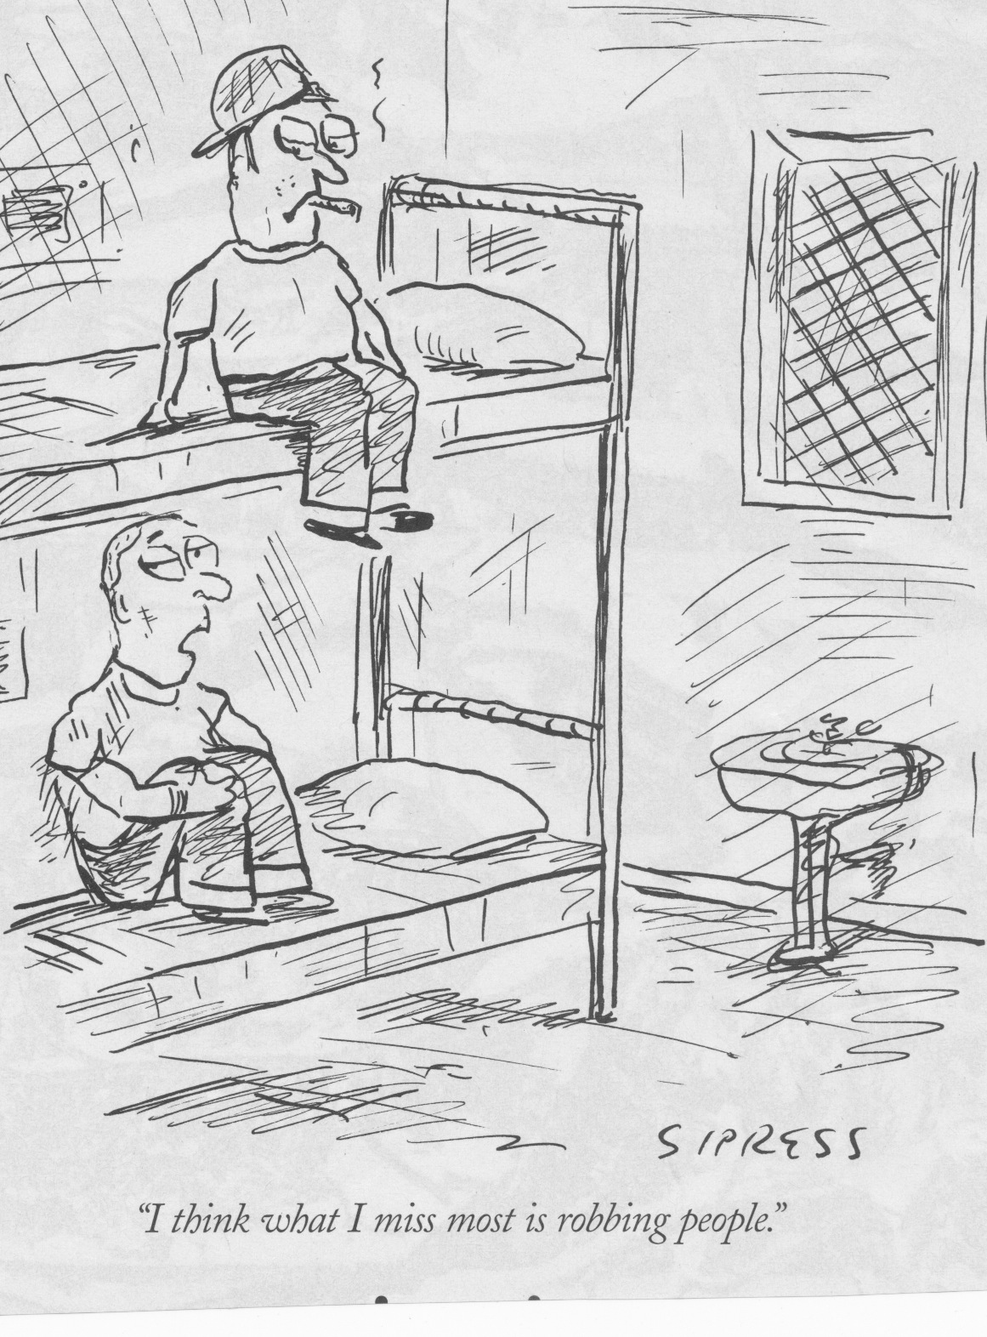
Bruce Carruth, Ph.D.

Slide 45
Amoral Antisocials (con’t)
• Has impulse control – plans and plots and can
delay gratification
• Often quite glib, superficial in relationships
• Focus is on image and impression management
• To understand amorals, watch The Sopranos.
Tony is an amoral antisocial pattern disturbance
Chris is an amoral/impulsive antisocial personality
disorder
Bruce Carruth, Ph.D.

Slide 46
Extroverted (narcissistic) amoral antisocials
• Grandiose, projects shame
• Entitled, flaunts privilege
• May be arrogant, condescending of others but at same time,
may show false humility
• Attracts “trophy” friends and mate
• Often high achievers, but cheats to get there
• High on impression management
• Needs others for validation
• Tony Soprano has a high functioning extroverted antisocial
trait/pattern disturbance
Bruce Carruth, Ph.D.

Slide 47
Introverted (schizoid) amoral antisocials
• Loners, often little need for others, hides shame
• Deficits in social skills
• Often seems aloof and disdainful of others
• Highly sensitive to real or perceived shaming
• Outwardly non-competitive, but losing really hurts
• Good plotters – can carry a grudge for years
• Can have an active paranoid flavor
• Poor relationships with opposite sex
• The withdrawn murderer in “Fargo” was an introverted
amoral APD
Bruce Carruth, Ph.D.

Slide 48
Impulsive antisocials
• Lack impulse control
• End up in social/health services in crisis
• Low feeling (except anxiety), feel through thrills and high risk:
“Let’s have some fun!”
• Often history of learning problems, school & social failures, low
self esteem
• May be impulsively violent
• High tolerance for pain – dissociates easily
• High risk for drug use, drug dependence
• Trouble explaining motivations – low insight
• Low guilt, high remorse
Bruce Carruth, Ph.D.

Slide 49
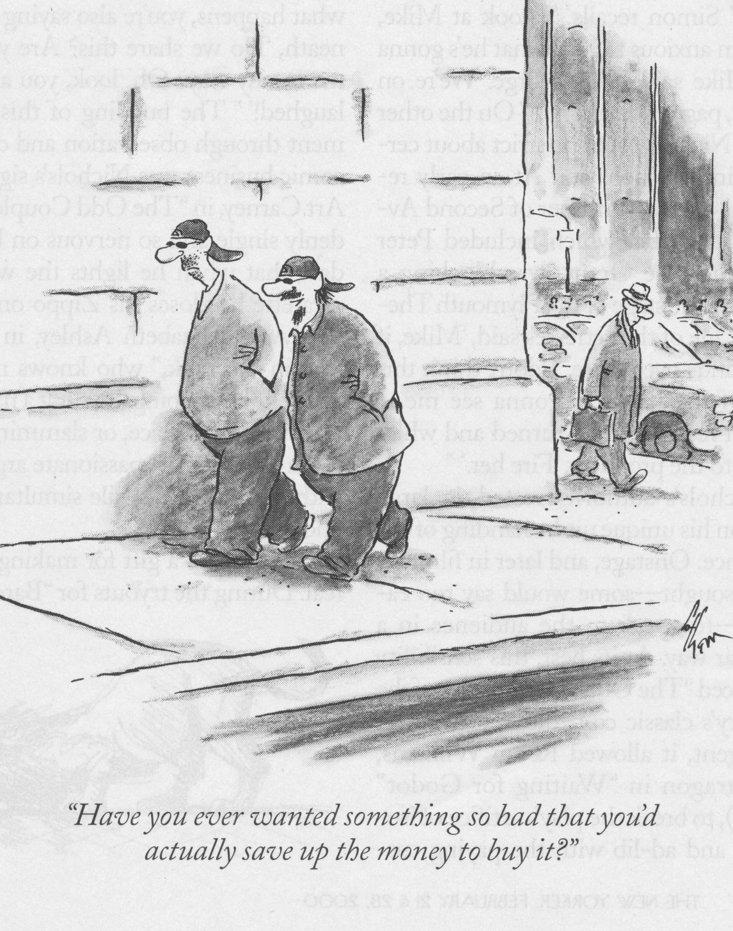
Bruce Carruth, Ph.D.

Slide 50
Sadistic Antisocials
• Willingness / desire to inflict pain on others for
personal “satisfaction”
• Lack of caring and empathy for others
• Low feeling tone, feel through the pain of others,
may overreact with feelings
• Usually, but not always, history of pervasive childhood
abuse and trauma
• Intense need to control and dominate
• Has little or no remorse for actions, justify and rationalize
behavior (and believe it).
Bruce Carruth, Ph.D.

Slide 51
Sadistic Antisocials
• Sadism is about getting over on people (or animals) and
getting a rush from inflicting pain or helplessness
• Not all sadistic people are antisocial, even though the specific
behavior may be regarded as sadism.
• One culture may consider a specific behavior sadistic while
another does not.
• Sadism almost always has an element of “The Big Secret”
Bruce Carruth, Ph.D.

Slide 52
The Big Secret
• If and when sadistic antisocials appear for treatment, they
most likely will present with other problems, such as needing
detox or presenting with marital/interpersonal or job
problems, rarely for their sadistic behavior.
• As a result, their sadism go unrecognized and untreated.
Bruce Carruth, Ph.D.

Slide 53
Does treatment really make antisocials worse?
YES, if people are treated with inappropriate treatment approaches
YES, if treatment stops at confronting primary, primitive ego defenses of the person:
→Grandiosity and omnipotence
→arrogance and glibness
→getting over on / manipulativeness
→denial and dissociation
→projection
Bruce Carruth, Ph.D.

Slide 54
Does treatment really make antisocials worse? (con’t)
• Therapy (and the treatment environment) has to support
the severely wounded self as it emerges. Shame, degradation, vulnerability and exposure are difficult for the individual to tolerate.
• Antisocial people almost invariably have to get worse (exposure of wounded self) before they can get better.
And the “getting worse” is hard for the treatment staff
to tolerate
Bruce Carruth, Ph.D.

Slide 55
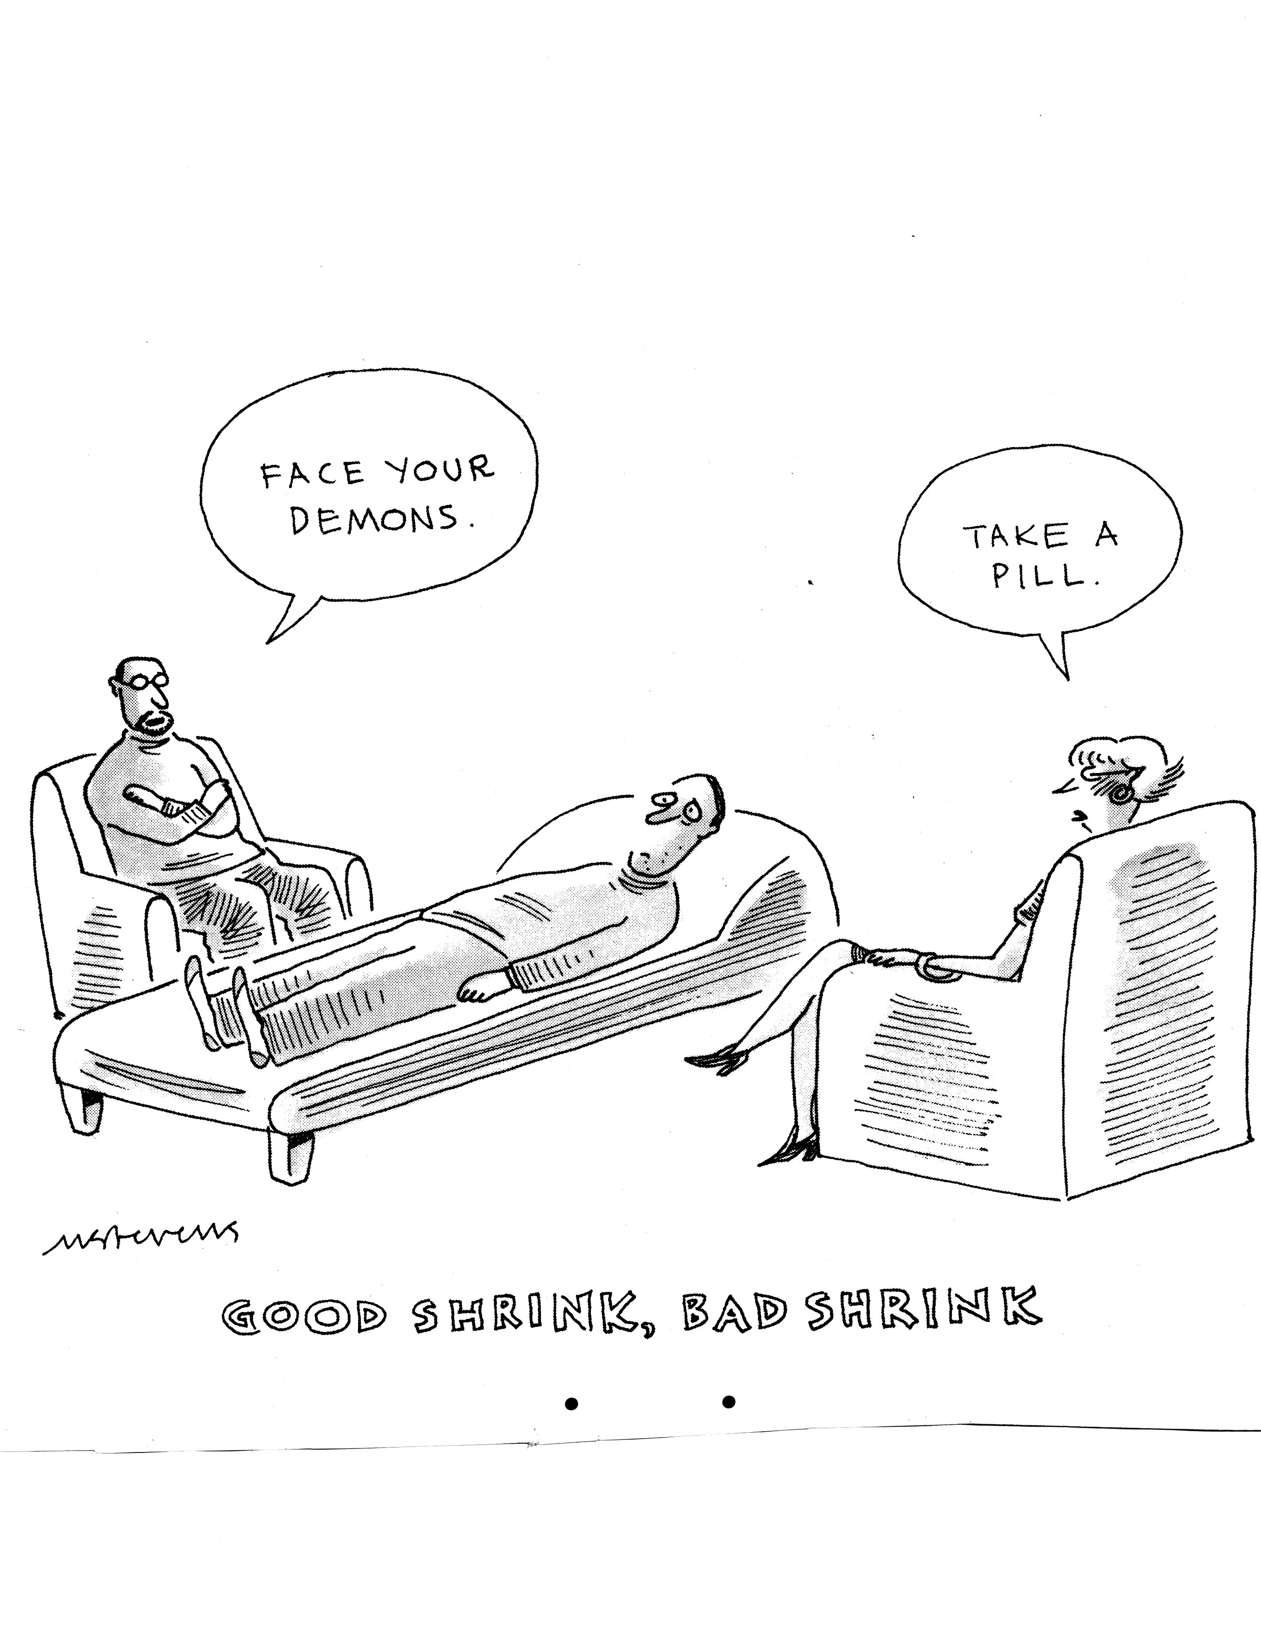
Bruce Carruth, Ph.D.

Slide 56
Some principles of therapy with antisocials
1. Focus is on doing, not talking – behavioral orientation –
especially early in treatment
2. Focus is on outcomes of behavior, not the meaning
of the behavior
3. Feelings don’t count in the early treatment
4. Omnipotence and grandiosity have to be confronted.
Can’t let the antisocial person “get over” on you.
5. Have to build a greater capacity for personal responsibility
6. Have to build a stronger capacity to experience anxiety
7. Have to confront and refute client’s fears of being used
8. Have to build a basic capacity for experiencing a conscience
Bruce Carruth, Ph.D.

Slide 57
Some principles of therapy with antisocials (con’t)
9. Heavy confrontation only works in institutions and in movies
10. Have to confront the myth of the “heroic outlaw”. Robin Hood
doesn’t live in your treatment center
11. Therapist has to maintain authority without being authoritarian
12. The paradigms that are the basis for therapy with other personality
disorders cause increased anxiety and acting out:
— insight = gaminess
— empathy = weakness / manipulation
— relatedness = intrusion
— trust = stupidness _ “I’m untrustworthy, why would I trust you?
Bruce Carruth, Ph.D.

Slide 58
A caveat about 12-Steps and antisocials
The honesty, openness, connectedness, (and sometimes the shaming) in AA and other 12-Step programs can make people on the antisocial spectrum very anxious.
To re-regulate, antisocial people will begin to act out and may:
• violate confidentialities
• seduce people emotionally or sexually
• use well intentioned program members to manipulate others
(or systems)
• borrow (and not repay) money
• sabotage other’s abstinence and recovery
NOT EVERYONE IS A SUITABLE CANDIDATE FOR 12-STEPS
Bruce Carruth, Ph.D.

Slide 59
The power of a contained environment in early treatment
• Most people in early treatment need the safety of a contained
environment to be able to accept and process the confrontation
• The shame that emerges in the confrontation has to be managed
• Group support of people who have “been there” is important
• Treatment needs to consider where the person is (in the moment)
on the “antisocial triangle”
Bruce Carruth, Ph.D.

Slide 60
The antisocial triangle
Withdrawn – Detached
(on the inside) (on the outside)
(Some trigger occurs)
Defense
sees self as victim
denies responsibility
placates, apologizes
has to get revenge
gets over
Activates
gets in trouble / manipulates
reacts to environment
creates excitement
Bruce Carruth, Ph.D.

Slide 61
The antisocial triangle - TREATMENT
Withdrawn – Detached
(on the inside) (on the outside)
therapy is to engage / experience /contact
(Some trigger occurs)
Defense
therapy is anxiety mgt /
Activates
articulating fears
Confrontation
finding safety
hearing feedback
cons and manipulates
creates triangles & chaos
therapy is awareness / coping skills /
staying with / within self / relational
Bruce Carruth, Ph.D.

Slide 62
6 domains of treatment:
• Behavior control
• Cognitive disortions
• Affect regulation
• Interpersonal relationships
• Drug use and addiction
• Psychological trauma
Bruce Carruth, Ph.D.

Slide 63
The domains and phases of treatment
Phases of Tx
engagement cognitive reconstructive selfwork
Domains
Behavior
control
Cognitive
distortions
Affect
regulation
Bruce Carruth, Ph.D.

Slide 64
Domains and Phases (continued)
Phases of Tx
engagement cognitive reconstructive selfwork
Domains
Interpersonal
relationships
Drug use &
addiction
Psychological
trauma
Bruce Carruth, Ph.D.

Slide 65
The overall context for treatment of antisocial people
The antisocial diagnosis
recognizing antisocials when you see them
being able to differentiate types of antisocials
The level of impairment
some folks look sicker than they are,
others look a lot healthier than they really are
The particular issues or domain of life we are addressing
(addiction issues, coping skills, relationships…)
The phase of treatment
Bruce Carruth, Ph.D.

Slide 66
Five levels of treatment contracts with antisocials:
treatment engagement
1. forced contracts – mandated treatment – no choice
2. conditional contracts – go to jail if you don’t…
3. low medical contracts – conversion experiences
(something outside of me has to fix me)
4. high medical contracts – I’ve got to change my life
5. growth contracts – I want to be a better person
Bruce Carruth, Ph.D.

Slide 67
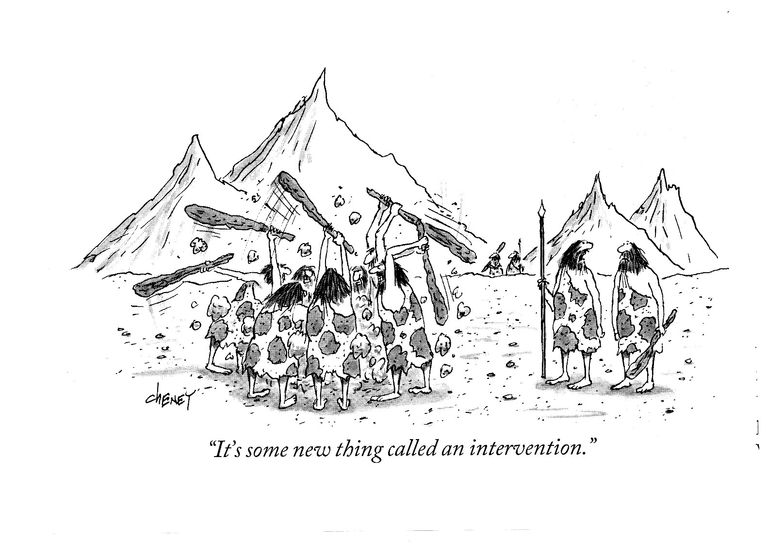
Bruce Carruth, Ph.D.

Slide 68
Getting started with treatment: Working with defense and resistance
Cognitive filters: mini-scripts, cognitive/perceptual distortions, beliefs/truths, stereotypes
Coping behaviors: withdrawal, distraction, boredom, dominating, manipulating
Interpersonal: using others, withdrawing, controlling others, arguing/polarizing, compliance
Psychological: deflecting, retroflecting, projecting, introjecting, confluence,
Bruce Carruth, Ph.D.

Slide 69
The importance of loving / caring confrontation
• Behavior HAS to be confronted
• Never confront personhood or shame the person
(you are a jerk!)
• a 4 step confrontation process
1. I care about you and your efforts
2. Here is what is going on (in behavioral terms)
3. Feedback from others (me) (impacts of behavior)
4. Here is what I (we) want you to do (corrective action)
Bruce Carruth, Ph.D.

Slide 70
The inpatient / residential experience
• Antisocial people with personality pattern disturbances or personality disorders can rarely move into recovery without a confined residential treatment experience.
• The residential experience allows behavior, ego defense and core schema to be challenged.
• Builds capacity for bonding & exposure of wounded self
• But 30 or 60 days isn’t enough: The person needs to experience sustained safety, identification, emotional regulation & the beginnings of a new value system
Bruce Carruth, Ph.D.

Slide 71
The meaning of the conversion experience
• The meaning of having a safe community to step into:
→intensive AA/NA/CA based residential TC that
transitions to community based 12-Step programs
→fundamentalist religions
→“exotic” spiritual practices
→certain military groups
• “Give me some boundaries and a value system until I can develop my own”
• As the person moves through recovery they may need to reject some of the dogmatism they have previously incorporated
Bruce Carruth, Ph.D.

Slide 72
Phase two: Cognitive/behavioral based change
Confronting the antisocial schema – watching the antisocial act out their world view in the treatment.
Developing self support & managing anxiety
Curative factors in individual and group treatment – confrontation, questioning values, attaching and belonging, self-exposure.
Making connections between current functioning and history
Managing the wounds as they appear: – the bully kid, the invisible kid, exposing childhood trauma, not knowing how to handle support, supporting exposure of and managing the “empty depression”
Managing self dynamics as they appear in treatment: shame, loneliness, feeling repression & especially, neediness/deprivation.
Bruce Carruth, Ph.D.

Slide 73
Limiting beliefs of antisocial people
• People will take advantage of me if given the chance
• I need to be in total control of my emotions
• If I want something, I can do whatever I need to do to get it
• Being controlled or dominated by others is intolerable
• I’m better off alone
• We live in a jungle and the strong survive
• People are schmucks & deserve what they get (but not me)
Bruce Carruth, Ph.D.

Slide 74
“3rd generation” CBT
DBT (Dialectical Behavior Therapy)
An integrated conceptual and practice framework for change anchored in:
—an accepting, well bounded therapeutic alliance
—reality testing & feedback from client, therapist and group
—mindfulness
—distress tolerance
—emotional regulation
—interpersonal effectiveness
• DBT was originally developed for people with Borderline Personality Disorder
• ACT is another useful 3-G cognitive-behavioral therapy
Bruce Carruth, Ph.D.

Slide 75
The existential depression
• Take away the shell and there is not much inside to embrace
– huge emptiness
• Meaninglessness – a lifetime of being a “screw-up”
&/or a “cover-up”
• The only way to get through the swamp is to go through it.
• Grieving the losses and what could have been
• SSRIs aren’t particularly helpful except in serious depression
• Never “tear someone down” if you don’t offer options to
rebuild their sense of self
• Suicide risk
• Countertransferential dynamics of the depression
Bruce Carruth, Ph.D.

Slide 76
Phase 3: Reconstructive work
→Developing a capacity for conscience: learning to care about the
needs of others
→Building new core schema, “world views”
→Continuing to support progress through the depression: being
the nurturing parent
→Developing self control
→Developing / enhancing interpersonal, social, occupational skills
→Evolving self-care: self soothing, self support, self assessment
→Developing an enlarged positive social, interpersonal, and
familial support system: learning to accept & utilize support
→Living with (rather than running away from) the history of
“the old way”
Bruce Carruth, Ph.D.

Slide 77
Building courage
• Antisocial people are not known for being courageous
• Bullies on the outside, anxious (weak) on the inside
• Courage as a psychological attribute
— bravery
— perseverance
— honesty (particularly self-honesty)
— zest - vitality
— belief in self – “You just don’t know who you are dealing with”
Bruce Carruth, Ph.D.

Slide 78
Phase 4: Developing Soul
→Allowing there to be a power greater than self: Belonging to:
Family
Community (for instance, AA & NA)
Ethnic identity
Spiritual identity
→Developing commitment – putting both feet on the rug
→Moving from being an outcast to being a citizen
→The spiritual search – the search for meaning
→We build self in therapy, we build soul in belonging
Bruce Carruth, Ph.D.

Slide 79
Some specific treatment issues with antisocial subtypes
• Amorals
• Impulsives
• Sadists
Bruce Carruth, Ph.D.

Slide 80
Treating amoral personalities
High functioning character trait disturbances
• Being the incorruptible, well bounded, interested parent.
The interest is in the person, not the exploits
• Early in treatment have to respect that the person is
“sicker” than they look.
• Narcissistic stance & schizoid withdrawal
• Boundaries of therapy are behaviorally based:
Clean confrontations of behavior, never shaming
Bruce Carruth, Ph.D.

Slide 81
Treating amoral personalities (con’t)
• Process of therapy is cognitive/behavioral and relational
• Working attachment through therapeutic relationship and
AA sponsor or significant others
• Co-opting the antisocial traits: charm, manipulativeness,
resourcefulness, reading others, survival skills
• Conversion (immersion) in AA, spiritual program, treatment
• Managing the “zero state”, narcissistic depression that emerges
when defenses are down
Bruce Carruth, Ph.D.

Slide 82
Treating amorals
Character pattern disturbance
• Clear behavioral contracts – therapy is about achieving
behavioral tasks
• Have clear, forced contracts for treatment – can’t quit
• Boundaries and process of treatment is behaviorally based
• Goal is to keep person in treatment long enough to
“move up” to character trait disturbance
•Therapy has to be a “crucible” to expose and contain the
rage without resorting to violence
Careful about using 12-step programs. Client will get anxious and manipulate others in AA to “get over” & reduce anxiety.
Bruce Carruth, Ph.D.

Slide 83
Treating amorals (con’t)
Personality disorders
• Treatment is a long term therapeutic community
• Treatment goal is to:
— Internalize behavioral controls and boundaries
—“conversion” experiences for new value / ethical system
— develop a sense of affiliation and connection with
organizations and other people
• Institutional constraints have to be able to contain the
acting out that is a result of anxiety generated in treatment
Differentiate consequences from punishment!
Bruce Carruth, Ph.D.

Slide 84
Treating impulsive character structure
Character trait disturbances
• set strong boundaries: show up and follow the rules
• increase capacity to delay gratification
• increase sense of control, internalize locus of control
• continued focus on assessing consequences of behavior
• supporting compliance / conforming behavior
• look for co-occurring ADHD – childhood or adult onset
• R/O other organic bases of impulse problems
• R/O trauma history that promotes impulsivity & outbursts
Bruce Carruth, Ph.D.

Slide 85
Treating impulsive character structure (con’t)
Character pattern disturbances
• behavioral constraints
• clear consequences / penalties for rule violations
• emphasis on responsibility for actions
• may need SSRI’s to help control anxiety
• needs group support to control impulses
Bruce Carruth, Ph.D.

Slide 86
Treating sadists
Character trait disturbances
• Clear behavioral contracts that define conditions of treatment
and proscribed behaviors and people/places/things
• Treatment of choice is long term, intensive group that allows:
identification & affiliation, confrontation & a “holding” community
• Early in treatment, the “victimization defense” has to be
confronted: responsibility for acts
• Treatment has to ultimately address sadists own trauma
• Abuse in treatment settings activates the sadist’s trauma
which activates defense which activates sadistic behavior
• Aversive counter-transference with sadists has to be managed.
• Clinical supervision is essential
Bruce Carruth, Ph.D.

Slide 87
Cycle of sadism
trigger experiences
internal (memories) or external (movies)
remorse or withdrawal
heavy ego defense
Activates trauma hx
affects/cognitions
Acts out to
re-regulate
Activates ego defense
affect repression /“thinking defense
fantasy / withdrawal
Bruce Carruth, Ph.D.

Slide 88
Treating sadists
Character pattern disturbances
• Confrontation in a “contained” environment
• No victimization, no excuses, no acting out
• Identification of sadism as “problem” & recognition of the
need for treatment and recovery
• Confrontation of attempts to draw others into victimization
defense
• Co-managing treatment and punishment for sadistic acts
Personality Disorder
• institutionalization & long term intense supervision
Bruce Carruth, Ph.D.

Slide 89
The difficult “tri-occurring” disorders
Antisocial character structure
Psychological
trauma
Addiction
Bruce Carruth, Ph.D.

Slide 90
The symptoms of all three disorders overlap
• Chronic psychological / emotional withdrawnness
• Hyper-reactivity to stimuli
• Underlying depression w/ surface anxiety
(the “anxious depression”)
• Huge fears of “insides coming out”, exploding,/being found out
(exposed) – highly defensive
• Feeling repression, low introspection
• Low trust (of insides and environment)
• High need for control
Bruce Carruth, Ph.D.

Slide 91
Treating “tri-occurring” disorders
• Treatment requires a remarkable degree of safety,
boundedness & consistency
• Safety occurs over time
• All 3 disorders have to be acknowledged, (tho any one
may be the primary focus of treatment at a given time)
• Integrated treatment is mandatory
sequential & parallel treatments don’t work
• Relapse in one activates the others
• Growth and recovery from one facilitates recovery
from the others
Bruce Carruth, Ph.D.

Slide 92
How can antisocial people change ?
1. Change for antisocial people has to address a whole way of life.
social system, family, occupation, sense of self, interpersonal
relations, trauma recovery…
Antisocials love to marry histrionics, borderlines and other
antisocials & then they are married to them – and stuck
2. Confronting problems in the antisocial’s life changes the
problem but not the person.
3. Antisocials don’t respond positively to traditional mental
health / addictions treatment … makes them nervous
Bruce Carruth, Ph.D.

Slide 93
Change process for antisocials (con’t)
4. change doesn’t come in once a week, individual therapy. Need more intensity & control
higher functioning antisocials can benefit from outpatient therapy,
lower functioning people need more intensive treatment & support
5. change agent system has to be consistent, firm, committed to
long term change and must involve a change in core values and
beliefs
6. religious conversion may be a primary change agent (see # 5,
above)
Bruce Carruth, Ph.D.

Slide 94
Change process for antisocials (con’t)
7. you can’t punish an antisocial into good citizenship and
behavior
8. at some time in treatment the core emptiness and fragility will
emerge as a major depression
9. from this emptiness, a new sense of self can grow and flourish
Bruce Carruth, Ph.D.

Slide 95
Why
Bother ???
Bruce Carruth, Ph.D.

Slide 96
For more information
Overheads are on website:
www.brucecarruth.com
Email me @: brucecarruth@gmail.com
Bruce Carruth, Ph.D.

Slide 97
Bruce Carruth, Ph.D.

Slide 98
Bruce Carruth, Ph.D.

Slide 99
Bruce Carruth, Ph.D.

Slide 100
Bruce Carruth, Ph.D.

Slide 101
Bruce Carruth, Ph.D.

Slide 102
Bruce Carruth, Ph.D.

